Slide 1
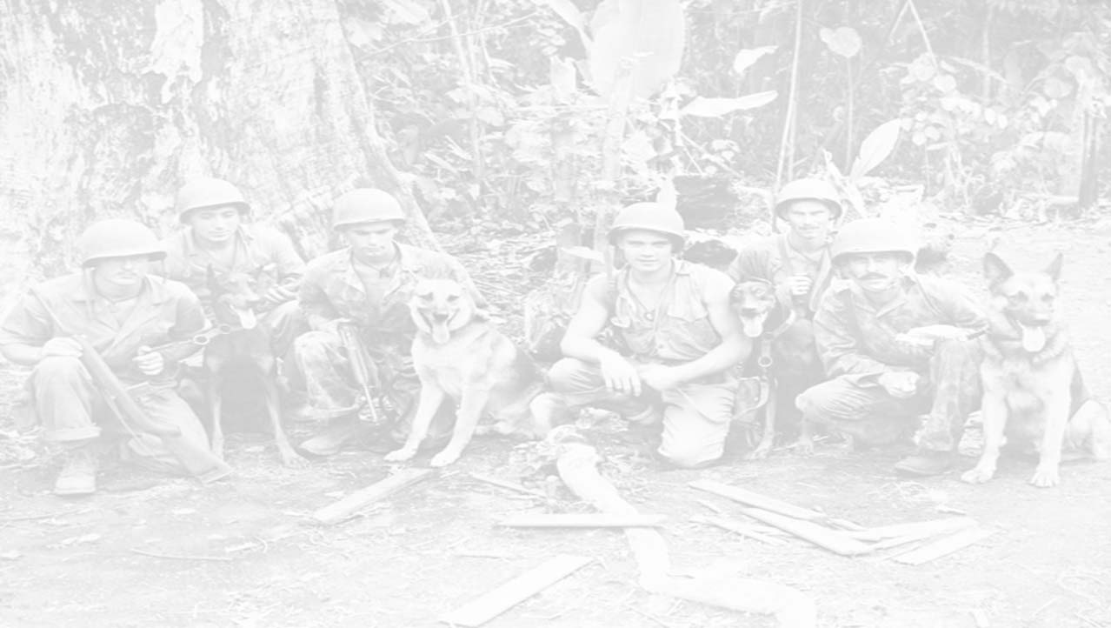

THE WAR DOGS OF VIETNAM

Slide 2
During the Vietnam war, America suffered an enormous amount of casualties due mainly to the unexplored tunnels used by the Viet Cong and the North Vietnam Army also known as the NVA. Because of those casualties, the U.S. engaged in the use of War Dogs, mainly specially trained dogs to assist with the exploration of tunnels as well as sentries, scouts and trackers. The most common breed of dog was the German Shepherd due to the easiness of training the dogs as well as the dogs’ dedication to its master.

Slide 3
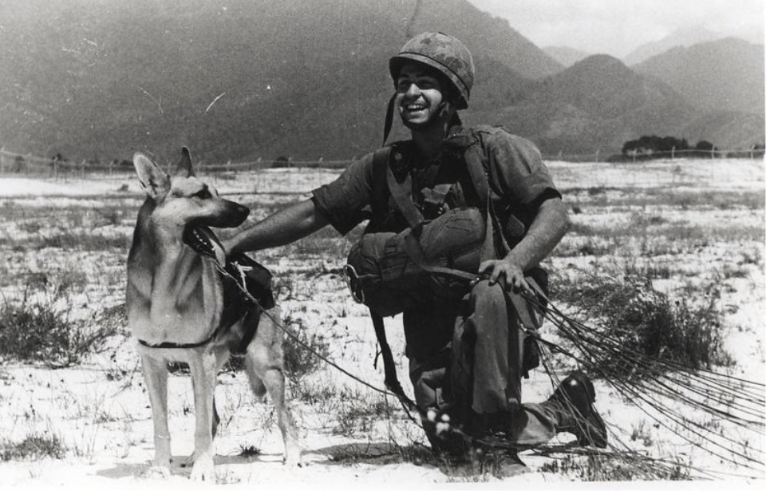

Slide 4
War Dogs in Vietnam were extremely versatile; they conducted sentry and scouting duties, mining as well as tunneling, and even some tracking. Rick Claggett was an Army dog handler during the Vietnam War (circa 1969), assigned to the 148th Infantry Scout Battalion. He trained with tracker/scout dogs and worked with a German Shepherd named Big Boy, who helped detect ambushes and booby traps, forging a deep bond with Claggett. He explained that their role was to lead the patrol through the field while the dog tried to scent booby traps and ambushes.

Slide 5
As the first man through, it was an incredibly dangerous job with, according to him, the third highest mortality rate in the war. Sentry dogs walked the perimeters of US outposts and acted as the first line of defense against the enemy. German Shepherds were also used on water patrols, trained to detect enemy soldiers hidden below the surface, waiting to attack amphibious craft. These well-trained teams soon became the target of Viet Cong guerrillas, who offered a bounty for killing a dog or their handler and started to attack their kennels to make this happen regularly. Rick has spoken about the heartache of leaving his dog behind.

Slide 6
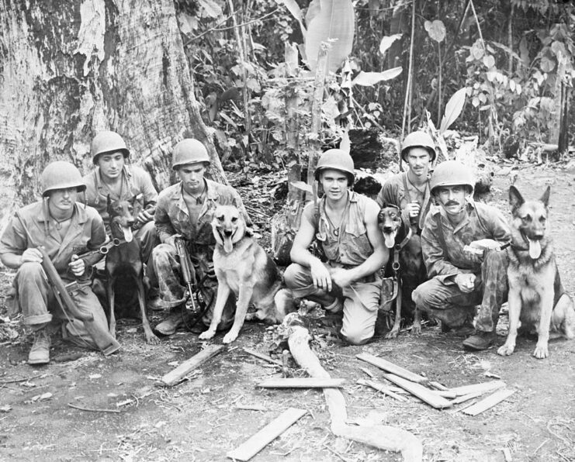

Slide 7
At the end of the war, only about 200 dogs of the 4,000
specially trained dogs were brought back to the United States. About 232 were killed in action and another 200 were assigned to posts outside of the U.S. The balance were either transferred to the South Vietnamese Army, systematically euthanized, or abandoned. As the result of this unjustified end, Robby’s Law was passed by Congress in 2000, which provides adoptable dogs to be offered first to former military dog handlers, then to Law Enforcement and finally, to qualified families. Since Robby’s Law was instituted, approximately 90% of retired Military Working Dogs are adopted, primarily by the handlers, while hundreds more go to law enforcement or families annually.

Slide 8
During their use, the War Dogs were accredited with the saving of approximately 10,000 American lives by detecting ambushes, tripwires as well as enemy forces.
The dogs became so effective in their tasks that they became special targets for the enemy.
The service performed by these canines never went unforgotten, and there are countless interviews with veteran handlers who still remember their partnerships fondly. In 2019, they were publicly remembered when the Vietnam War Dog Team Memorial was unveiled at Motts Military Museum, Inc. in Ohio.

Slide 9
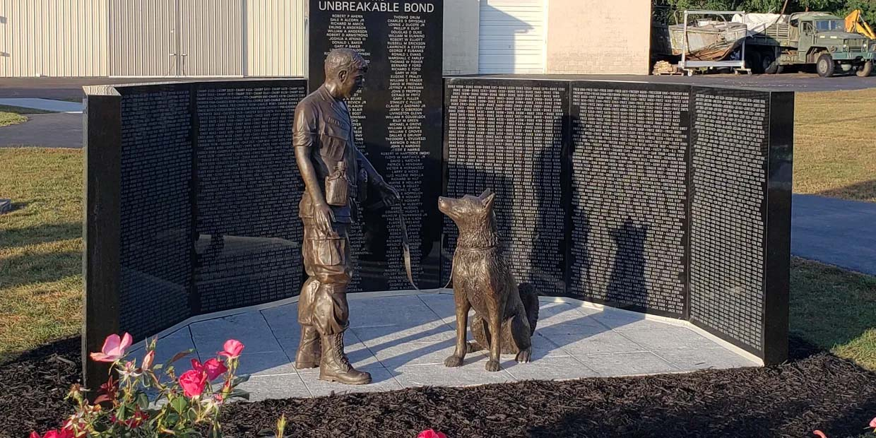

Slide 10
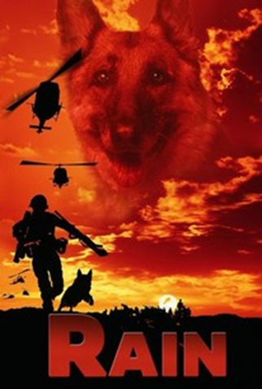
In 1968, American soldier Danny Davis is serving in Vietnam while also writing letters to his little sister Amy, who idolizes him and remains in the United States with his dog Rain for companionship. Sometime later, Danny is killed in action. Wanting to honor her brother's memory, Amy decides to give Rain to the army as a part of their training program in hopes that he can save more soldiers from being killed.
Rain is assigned to Private Joe Holland. While Holland initially has trouble working with Rain at first, he manages to train him through motivation of his love for Amy. Holland and Rain arrive in Vietnam and are assigned as part of the scouting team under Sergeant Crawford. Holland soon begins exchanging letters with Amy on a regular basis. When the team begins scouting through the jungle for V.C. soldiers, Rain saves Summers by tackling him when he falls in the line of fire and then Holland when he places his foot on a mine, which Summers disarms. The team is forced to camp for the night when Rain refuses to go forward after the humidity prevents him getting the enemies' scent. The next day, Rain senses danger in an open field. Holland advises against crossing, but Crawford doesn't listen, and the party is caught in an ambush, during which Gleeson, Junior and Papis are killed while the rest escape on a helicopter.
The survivors of the attack are returned to base for hospital treatment, where Holland meets and falls for tech Abby Palmer and Summers is resigned to a wheelchair. Rain at first refuses to eat or drink but pulls through when Holland reads him a letter from Amy. The pair soon rejoin the scouting party with a local boy named Ky guiding them on a mission to Chu Sang in search of enemy soldiers. When the party arrives at a river, Rain uses a rope for them to use and cross safely while dodging an enemy sniper who is shot by Jordan. They soon arrive at a village where Crawford demands information from one of the villagers, whom Ky claims his father. The man denies knowing anything, but when supplies is found belonging to the V.C., Crawford begins threatening him at gunpoint, but stops himself when Holland has Rain stand between him and the threatened man, and the party returns to base.
Holland learns from Abby that Ky's father was actually killed months ago. The news causes him to suspect Ky of being a spy when he disappears with Rain into the jungle, where he is knocked out by smugglers who capture Rain and carry him away for trade. Holland and Abby, acting on information from Mays, follow them to the river, where Holland sets a diversion with a flare to distract them while Abby tries to free Rain. Rain manages to escape and subdue one of the smugglers attacking Abby, while Holland knocks one of them out, and the rest are driven off or killed by a firing helicopter and the subdued man is shot dead by Summers, allowing the three of them to escape. Following the incident, Holland returns to the United States to release Rain back to Amy's family, and bids farewell to him before returning to the army. The film ends with a message commending the dogs who saved thousands of American lives during the Vietnam War.

