Slide 1
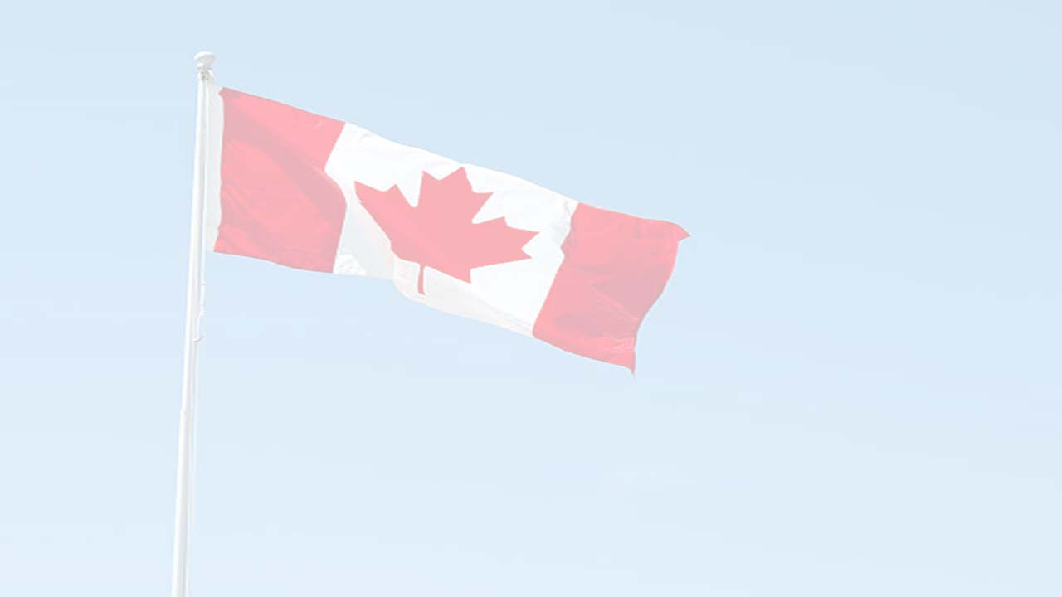

Canadians Involved
in the Vietnam War

Slide 2
At the start of the Vietnam War, Canada was a member of the International Control Commission (ICC) overseeing the implementation of the Geneva Agreements, and thus attempted to maintain an air of neutrality. However, the Canadian negotiators were strongly on the side of the U.S. One representative (J. Blair Seaborn, younger brother of Robert Seaborn) was even involved in secretly exchanging messages between the U.S. and North Vietnam on behalf of the U.S., with the approval of the Canadian government. Canada also sent foreign aid to South Vietnam, which, while humanitarian, was directed by the U.S.

Slide 3
While Canada remained neutral, approximately 20,000 to 30,000 Canadians crossed the border to volunteer to fight alongside the U.S. military, forming a significant foreign contingent. The reasons for this was attributed to a sense of duty, adventure or dissatisfaction with Canadian military opportunities.

Slide 4
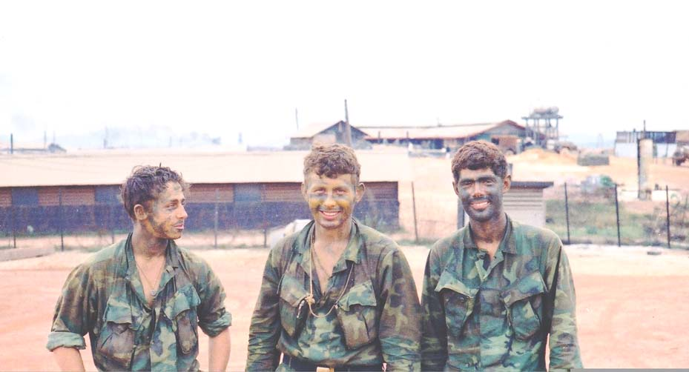

Slide 5
Approximately 12,000 served in combat roles of which at least 134 were killed or declared missing in action. Those who died during their duty in Vietnam have their names listed on the Vietnam Veterans Memorial in Washington D.C. Some of those that were killed and listed on the Wall are officially on record as being from Canada while others are listed from the town and state where they enlisted.

Slide 6
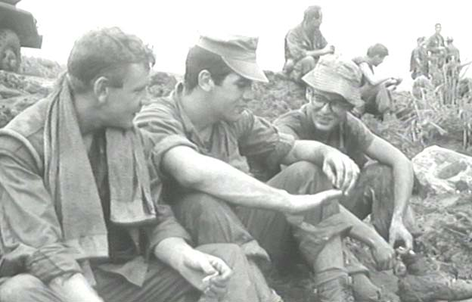

Slide 7
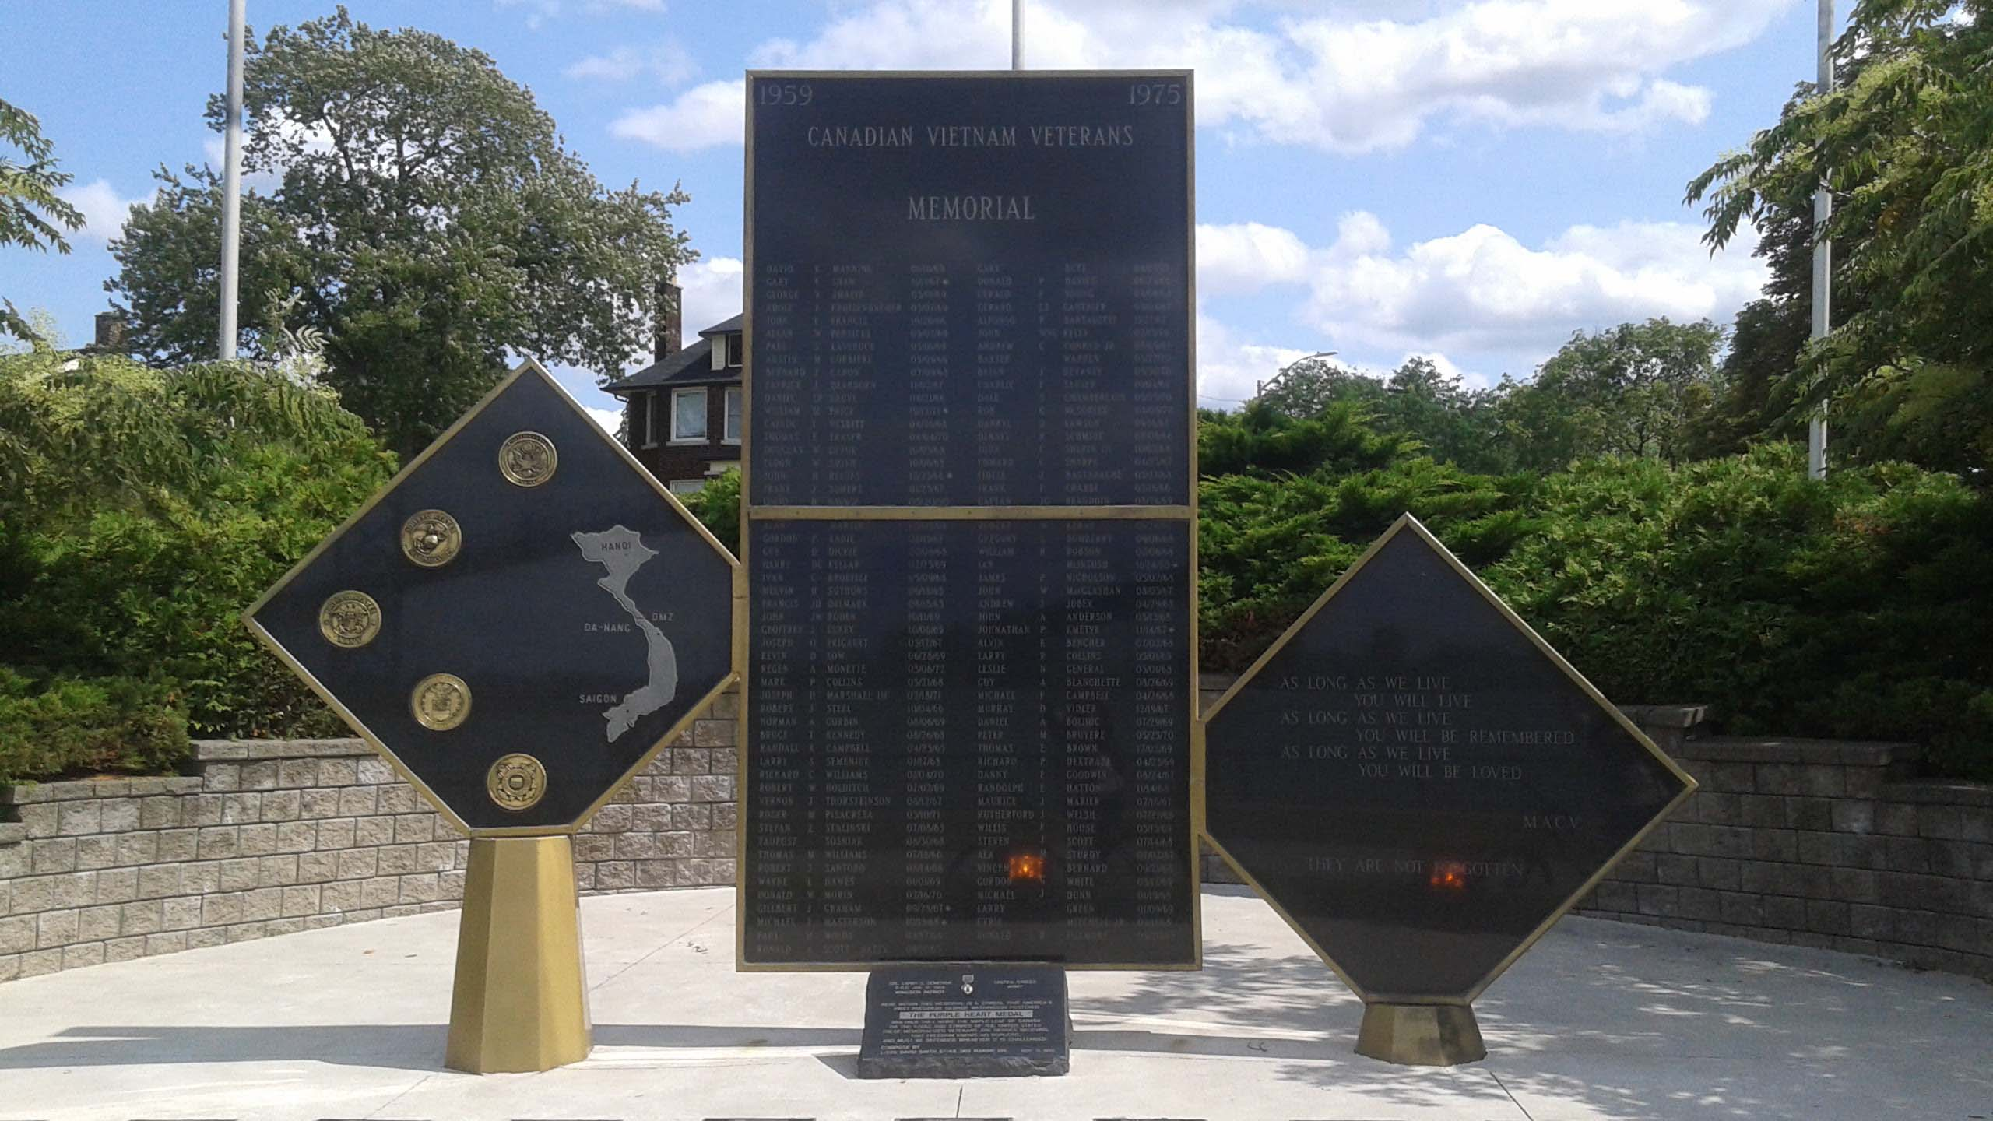
In 1995, some American veterans took up the cause for their Canadian colleagues and funded a memorial known as The North Wall that was built in Windsor, Ont.

