Slide 1
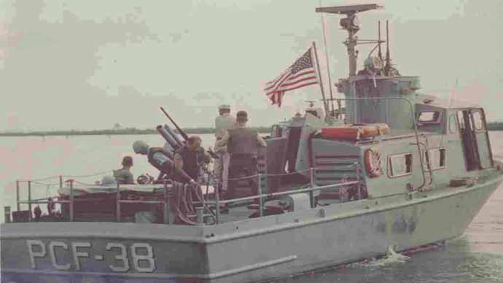
Brown Water Navy in Vietnam
1965 - 1973

Slide 2
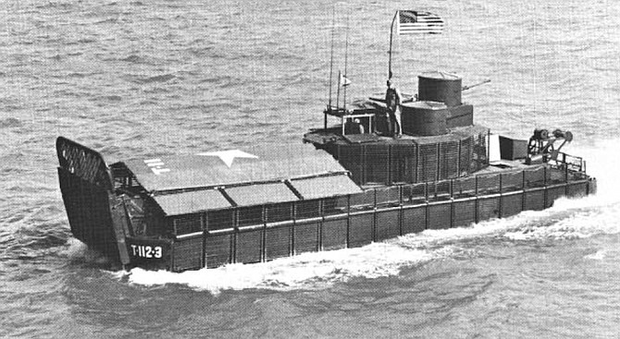
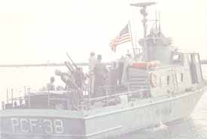
The Brownwater Navy was a specialized branch of the United States Navy formed during the Vietnam War to conduct operations in the shallow rivers, canals, and coastal waters of South Vietnam. Officially known as the United States Navy's "Riverine Forces,"
these units used small, heavily armed boats such as Patrol Boat, River (PBR), Swift Boats (PCF), and Armored Troop Carriers (ATCs) to provide mobility, firepower, and logistical support to U.S. Army and South Vietnamese forces. Brownwater Navy sailors faced constant ambushes, mines, and hostile fire while patrolling the Mekong Delta and other waterways. Their crucial efforts disrupted enemy supply lines, supported ground operations, and played a significant role in counterinsurgency missions throughout the conflict.

Slide 3
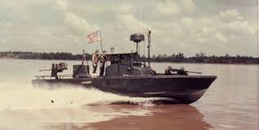
PBR (Patrol Boat, Riverine): The most common craft, these 31-to-32-foot fiberglass boats used dual waterjet drives to operate in shallow, weed-choked rivers. They were highly maneuverable, displaced just under 9 tons, and were heavily armed with twin .50 caliber machine guns.

Slide 4
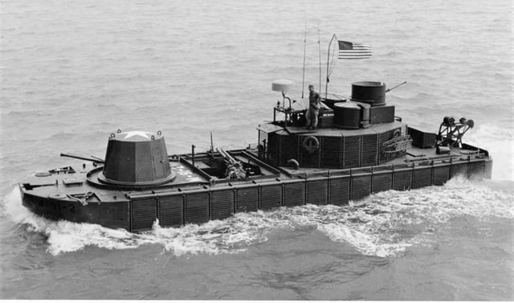
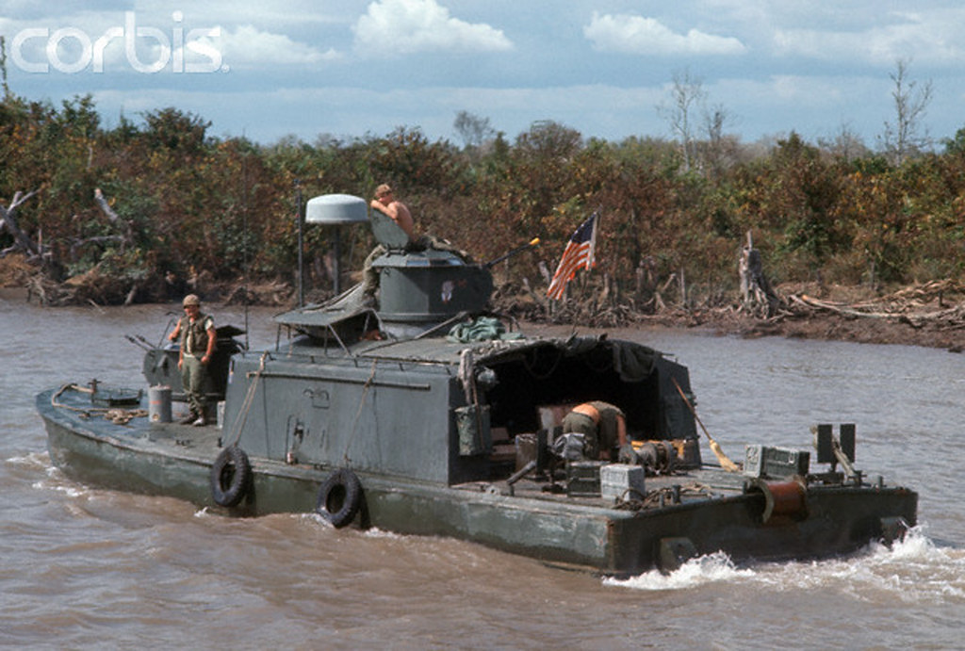
Monitors: The "battleships" of the rivers, these were heavily armored converted landing craft designed to provide heavy fire support for ground troops.
ASPB (Assault Support Patrol Boat): Known as the "minesweeper" of the riverine forces, they were heavily armed and reinforced for mine survivability.

Slide 5
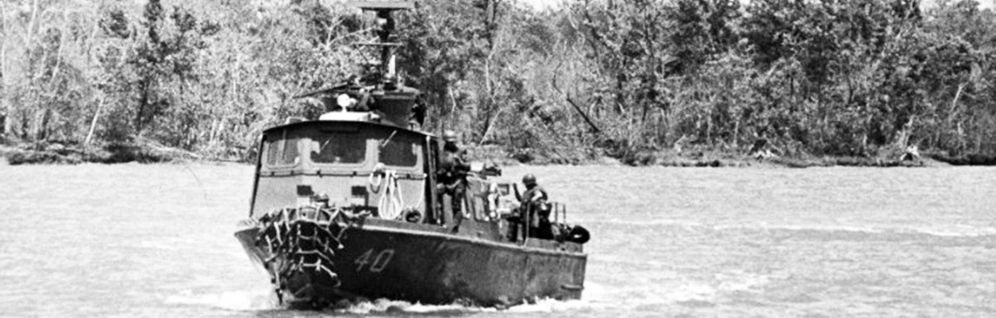
PCFs (Patrol Craft, Fast): Often referred to as "Swift Boats," these 50-foot aluminum craft primarily handled coastal and estuary patrols.
The Navy worked closely with the U.S. Army in the Mobile Riverine Force, a joint unit that combined Army infantry with Navy river boats to conduct coordinated assaults.

Slide 6
The ability to operate and fight on rivers and shallow coastal areas was critical. On Jan. 31, 1968, Viet Cong and North Vietnamese troops attacked over 100 of South Vietnam’s cities and towns. The offensive on the evening of Tet, the Vietnamese lunar New Year, came as a complete shock to both the United States and the Republic of Vietnam. The U.S. Navy quickly develop technology (to include off-the-shelf commercial technology), tactics, and personnel capable of waging war inshore and built a multi-mission, brown-water navy.
During the offensive, Navy small boats were employed for fire support, troop transport, amphibious assault, forward basing, logistical support, and numerous other missions. They, along with the U.S. Army troops they carried, proved to be instrumental in taking back some of the most valuable pieces of real estate in the country.

Slide 7
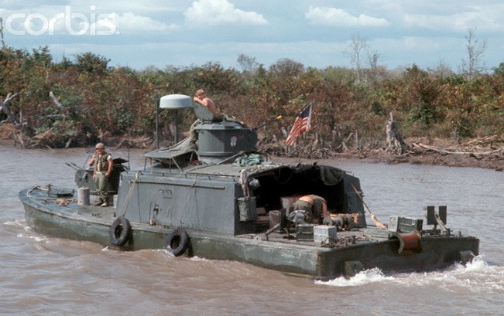
US Navy Riverine forces were crucial in I Corps keeping supply lines open on the Cua Viet and Perfume Rivers in support of the effort to retake Hue and the myriad other battles occurring along the northern I Corps AO and to the defense and recapture of a number of cities in the Delta during the Tet Offensive.
Vietnam was a watershed in many ways for the Navy. It represented the only time in its recent history that large numbers of sailors experienced riverine warfare in small boats — a combat experience more akin to that of an infantry soldier rather than a sailor on a large ocean-going surface combatant.
U.S. Navy Brownwater Fleet Used in Vietnam

