Slide 1
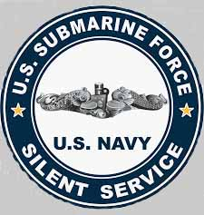
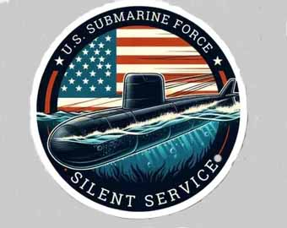
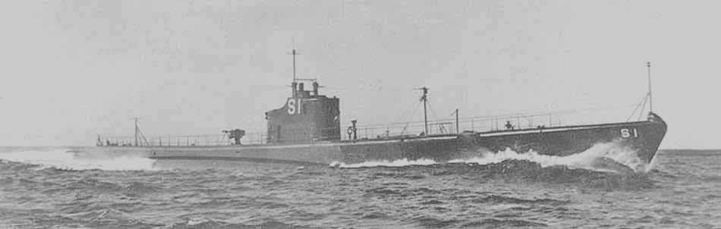
SUBMARINES OF THE U.S. NAVY

Slide 2
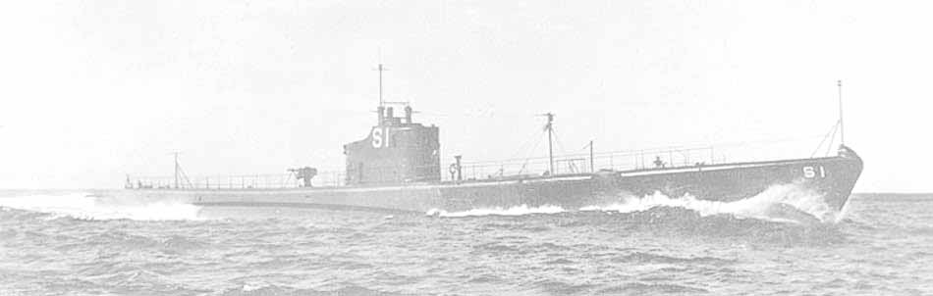
Submarines in World War II were primarily used as stealth hunters to disrupt enemy supply lines, destroy naval fleets, and enforce blockades. They operated as surface ships that could dive for limited periods, utilizing torpedoes and deck guns to devastating effect in both the Atlantic and Pacific theaters. Naval forces adapted their submarine tactics to strategic objectives based on the theater of war:
                Commerce Raiding & Blockades:
                The U.S. Navy used submarines to strangle Japan's economy by sinking nearly 5 million tons of shipping, destroying over 60% of the Japanese merchant marine. Similarly, German U-boats targeted Allied supply convoys across the Atlantic to starve Great Britain.
Naval Combat:
  Submarines actively hunted enemy warships. Though only a fraction of the U.S. Navy's force, they destroyed over 30% of the Imperial Japanese Navy, including major combatants like aircraft carriers.

Slide 3
During WWII, the USS Nautilus (SS-168), a V-boat diesel-electric submarine, was used for diverse combat roles, including special troop transport, shore bombardment, scouting, and delivering supplies to guerrilla fighters. She played a key role in the 1942 Makin Island Raid and the Battle of Midway.
Key WWII Missions & Roles:
Troop Transport & Raids:
Nautilus was notably used to carry the Second Raider Battalion ("Carlson's Raiders") to Makin Atoll in August 1942, supporting the mission with gunfire from her deck guns.
Guerrilla Supply & Support:
She was involved in transporting ammunition, fuel, and supplies to guerrilla fighters in the Philippines, and helped evacuate key personnel.
Combat Patrols:
She participated in multiple war patrols in the Pacific, sinking cargo ships (like America Maru) and damaging others.

Slide 4
Special Operations & Rescue:
Submarines covertly inserted spies and commandos, delivered supplies to resistance movements, and served in humanitarian roles. U.S. submarines were highly effective at rescuing over 500 downed carrier pilots from enemy waters.
Intelligence & Reconnaissance:
Because of their stealth, submarines were frequently used to gather intelligence on enemy fleet movements, map coastlines, and act as picket guards for larger surface fleets.
Minelaying:
Due to their ability to operate undetected, several nations, including Germany and Great Britain, used submarines to secretly plant naval mines in heavily trafficked enemy shipping channels and harbors.
Battle of Midway:
She participated in the Battle of Midway, where she hindered the Japanese destroyer Arashi, which led American aircraft directly to Japanese carriers.

Slide 5
Intelligence Gathering:
Used for reconnaissance, including taking pictures and correcting charts of enemy-held areas.
The Nautilus’s first patrol was off the coast of Midway Island to help repel the anticipated Japanese attack.
On the morning of June 4, 1942, while patrolling her northern most boundary of her patrol, she sighted multiple masts off the horizon. About the same time, Japanese planes spotted her and started strafing. A battle soon commenced. After approximately four (4) hours, the Nautilus raised to periscope depth only to see that the damaged Japanese ships had disappeared.

Slide 6




Her second patrol brought her off the coast of Makin Atoll to stage a raid to divert Japanese attention from the Solomon Islands. Upon her arrival, she sent the troops that she was transporting ashore on Butaritari Island in rubber boats rigged with outboard motors. At 07:03, she provided gunfire support against enemy positions at Ukiangong Point on Butaritari and shelled enemy ships in the lagoon, sinking two, a troop barge and a patrol boat. After days of battles, she loaded the surviving troops and set coarse for Pearl Harbor.
Nautilus completed her 14th, and last, patrol at Darwin on the 30th of January 1945. From Australia, she was routed on to Philadelphia, Pennsylvania, where she arrived on the 25th of May for inactivation. Decommissioned with a bottle of champagne over the forward 6 inch (152 mm) gun on 30 June, she was stricken from the Naval Vessel Register on the 25th of July and sold on the 16th of November, to the North American Smelting Company of Philadelphia, Pennsylvania, for scrapping.
During her years of service, Nautilus received the following awards:
Presidential Unit Citation, for her aggressive war patrols in enemy-
controlled waters.
American Defense Service Medal
Asiatic-Pacific Campaign Medal with 14 battle stars
World War II Victory Medal

Slide 7
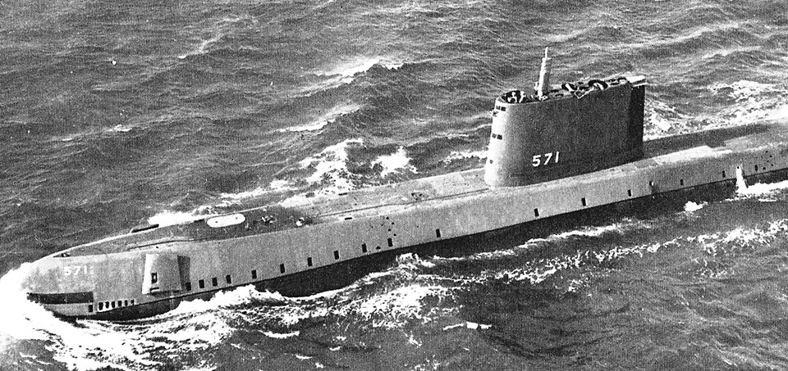
With the end of WWII, the Navy looked to the future. Admiral Rickover was
appointed head of a new office in the Bureau of Ships, the Nuclear Power Division.
It was ten (10) years, but in January, 1955, the USS Nautilus (SSN571), the
U.S. Navy’s first nuclear powered submarine cast away from the pier in
New London, Connecticut to go on it’s maiden voyage to Puerto Rico, 1,200
nautical miles away, completing the trip in 90 hours.

Slide 8
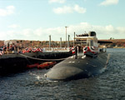
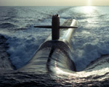
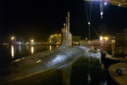
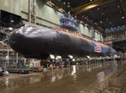
With the successful completion of the Nautulis’ maiden voyage as well as her successful voyages under the North Pole, the Navy marched forward to continue to expand their fleet. To date, the Navy has accepted 16 different classes of nuclear powered submarines ranging from fast attack submarines to ballistic missile submarines to guided missile submarines. Construction of those submarines was not casualty free. On April 10, 1963, the nuclear submarine USS Thresher was lost during deep-dive sea trials, claiming the lives of 129 crew members. Investigations concluded the disaster was likely caused by the failure of a salt-water piping joint. In response, the Navy created the Submarine Safety (SUBSAFE) Program to apply extreme rigor in the design, material selection, fabrication, and testing of critical systems.
Los Angles Class
Fast Attack Submarine
Trident Class
Ballistic Submarine
Seawolf Class
Submarine
Virginia Class
Fast Attack Submarine

