Slide 1
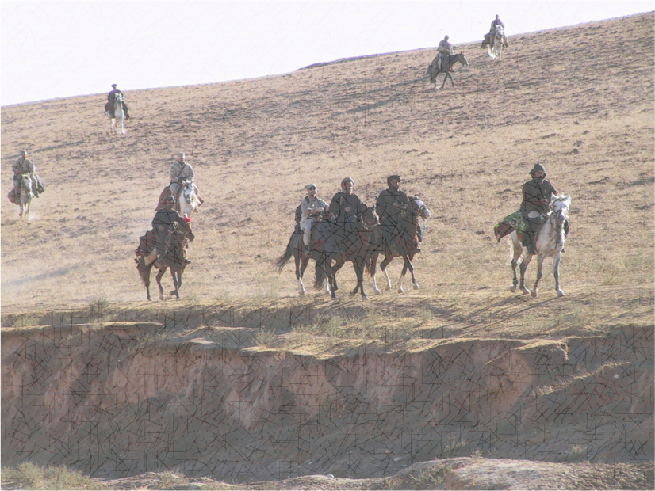
US INVOLVEMENT ON THE
AFGANISTAN WAR

Slide 2
The US led a coalition to invade Afghanistan to topple the
Taliban and combat al-Qaeda. The initial invasion started
on October 7,2001, using heavy airstrikes as well as ground support from anti-Taliban Northern Alliance. Known as Operation Enduring Freedom, this phase of the war led to the quick collapse of the Taliban.
The next phase was the Battle of Tora Bora from November 30, to December 17, 2001. This was a major military engagement targeting a cave complex in the White Mountains where Osama bin Laden was believed to be hiding along with Taliban and al-Qaeda troops. It is believed that bin Laden escaped by crossing the Pakistani border around the 15th of December. That was the last the US new of his where abouts.

Slide 3
Operation Anaconda (March 2002) was the first major ground assault and largest operation since Tora Bora. Nearly 2,00 US troops and 1,000 Afghan militia fighters battled hundreds of al-Qaeda and Taliban militants in the Shah-i-Kot Valley. During a 24-hour long battle, a handful of US soldiers killed hundreds of al-Qaeda fighters while repelling waves of heavily armed mujahideen trying to overrun an isolated hilltop position in the Arma Mountains of the southeastern Afghanistan.
In 2007, Operation Achilles, a major NATO-led offensive in the Helmand Province targeted Taliban insurgents to improve regional governance and security.

Slide 4
To stabilize a deteriorating situation in Afghanistan, President Obama issued orders to add an additional 17,000 troops to the 36,000 troops already stationed there. By 2011, US troops reached a peak of 110,000. In November 2010, NATO countries agreed to a transition of power to local Afghan security forces by the end of 2014, and, on May 2, 2011, following 10-year manhunt, U.S. Navy SEALs located and killed bin Laden in Pakistan.
Following bin Laden's death, a decade into the war and facing calls from both lawmakers and the public to end the war, Obama released a plan to withdraw 33,000 U.S. troops by summer 2012, and all troops by 2014.

Slide 5
In 2015, the Taliban continued to increase its attacks,
bombing the parliament building and airport in
Kabul and carrying out multiple suicide bombings.
In August 2017, Trump delivered a speech to American troops vowing "we will fight to win" in Afghanistan. "America's enemies must never know our plans, or believe they can wait us out," he said. "I will not say when we are going to attack, but attack we will.“
The United States and Taliban signed a peace agreement on February 29, 2020, although Taliban attacks against Afghan forces continued, as did American airstrikes.

Slide 6
In September 2020, members of the Afghan government met with the Taliban to resume peace talks and in November, Trump announced that he planned to reduce U.S. troops in Afghanistan to 2,500 by January 15, 2021.
Facing little resistance, in just 10 days, from August 6-15, 2021, the Taliban swiftly overtook provincial capitals, Kandahar, Mazar-e-Sharif and, finally, Kabul. As the Afghan government collapsed, President Ashraf Ghani fled to the UAE, the U.S. embassy was evacuated and thousands of citizens rushed to the airport in Kabul to leave the country.

Slide 7
By August 14, then President Biden had temporarily deployed about 6,000 U.S. troops to assist in evacuation efforts. Facing scrutiny for the Taliban's swift return to power, Biden stated, “I was the fourth president to preside over an American troop presence in Afghanistan—two Republicans, two Democrats. I would not, and will not, pass this war on to a fifth.”
During the war in Afghanistan, more than 3,500 allied soldiers were killed, including 2,448 American service members, with 20,000-plus Americans injured. Brown University research shows approximately 69,000 Afghan security forces were killed, along with 51,000 civilians and 51,000 militants.

