Slide 1
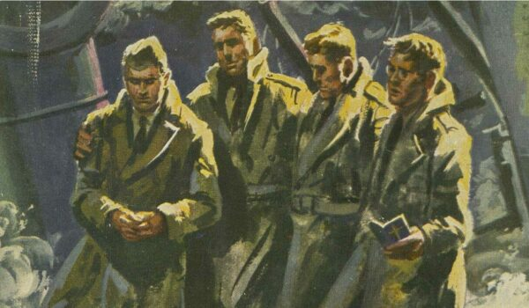
THE FOUR CHAPLINS
Tragedy at Sea
The sinking of the USAT Dorchester on February 3, 1943, was a tragic event during World War II, caused by a German torpedo attack.

Slide 2
On Feb. 3, at 12:55 a.m., a periscope broke the chilly Atlantic waters. Through the cross hairs, an officer aboard the German submarine U-223 spotted the Dorchester.
The U-223 approached the convoy on the surface, and after identifying and targeting the ship, he gave orders to fire the torpedoes, a fan of three were fired. The one that hit was decisive–and deadly–striking the starboard side, amid ship, far below the water line. Captain Danielsen, alerted that the Dorchester was taking water rapidly and sinking, gave the order to abandon ship. In less than 20 minutes, the Dorchester would slip beneath the Atlantic’s icy waters.

Slide 3
Through the pandemonium, according to those present, four Army chaplains brought hope in despair and light in darkness..
Those chaplains were:
Lt. George L. Fox, Methodist
Lt. Alexander D. Goode, Jewish
Lt. John P. Washington, Roman Catholic
Lt. Clark V. Poling, Dutch Reformed
Quickly and quietly, the four chaplains spread out among the soldiers. There they tried to calm the frightened, tend the wounded and guide the disoriented toward safety. “Witnesses of that terrible night remember hearing the four men offer prayers for the dying and encouragement for those who would live,” says Wyatt R. Fox, son of Reverend Fox.

Slide 4
By this time, most of the men were topside, and the chaplains opened a storage locker and began distributing life jackets. It was then that Engineer Grady Clark witnessed an astonishing sight.
When there were no more lifejackets in the storage room, the chaplains removed theirs and gave them to four frightened young men.
“It was the finest thing I have seen or hope to see this side of heaven,” said John Ladd, another survivor who saw the chaplains’ selfless act.

Slide 5
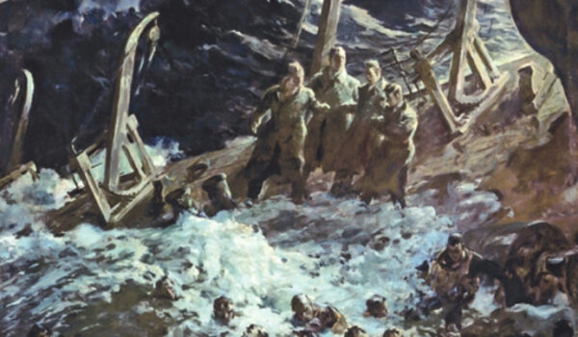
As the ship went down, survivors in nearby rafts could see the four chaplains–arms linked and braced against the slanting deck. Their voices could also be heard offering prayers.

Slide 6
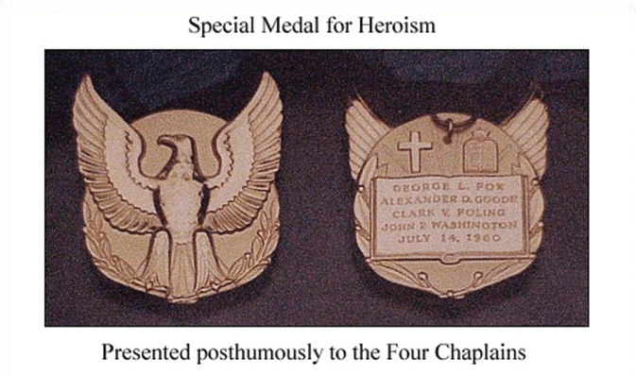
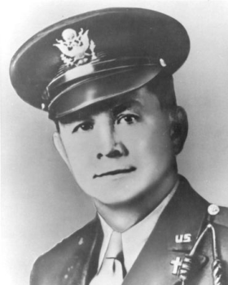
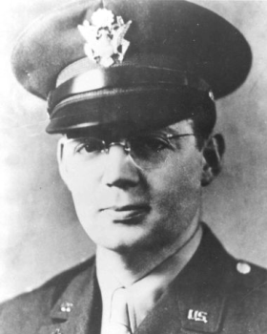
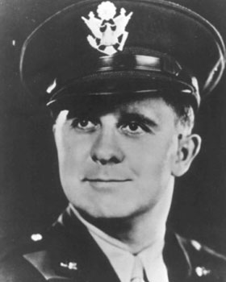
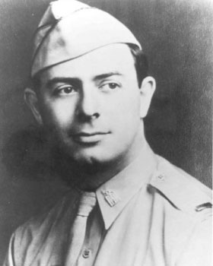
Lt. George L. Fox
Lt. John P. Washington
Lt. Clark V. Poling
Lt. Alexander D. Goode

