Slide 1

THE FALLEN NYPD OF THE 911 TERRORIST ATTACKS

Slide 2
On September 11, 2001, 23 members of the NYPD made the ultimate sacrifice while responding to the World Trade Center attacks, demonstrating unmatched bravery.
Their courage, along with hundreds of other first responders and victims, is honored through, with over 600 total law enforcement deaths now linked to 9/11-related illnesses.

Slide 3
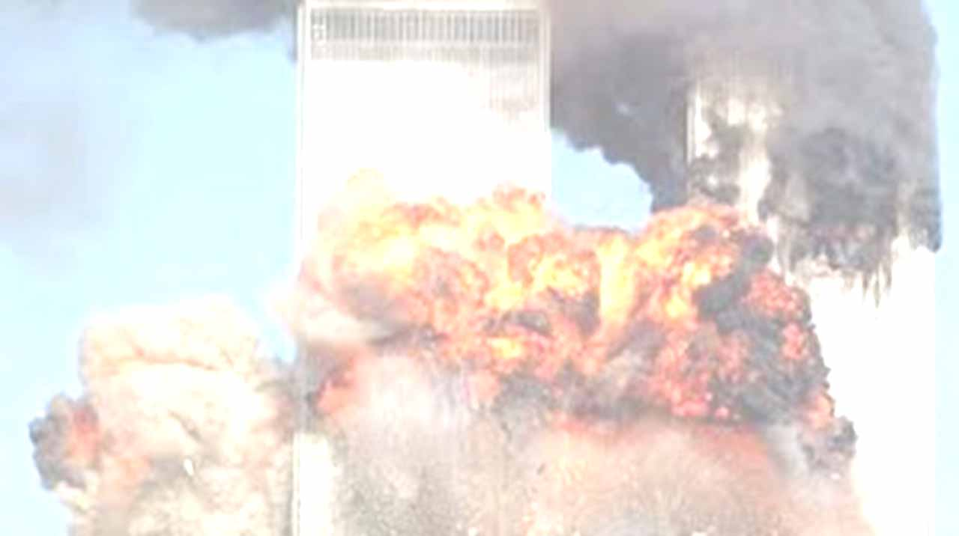
On the morning of September 11, 2001, Islamic jihadists terrorists vowing death to all Americans hijacked four passenger airliners. Two of those planes crashed into the World Trade Center towers in New York City, while another plane crashed into the Pentagon in Arlington, VA and the fourth plane, presumably headed for the White House or the U.S. Capitol, was heroically diverted by passengers and ended up crashing in an empty field in Pennsylvania. A total of 72 law enforcement officers perished on September 11, 2001.

Slide 4
After the impact of the first plane at the World Trade Center, the law enforcement community and fire and EMS personnel rushed to the site to assist with rescue and recovery.
The 23 NYPD officers who sacrificed their lives on that horrific day, served in various roles, including the Emergency Service Units and different precincts. Their bravery is remembered alongside the ongoing, immense loss within the first responder community.

Slide 5
Close to 3,000 people died on that fateful day. The NYPD responded to the World Trade Center buildings in a show of strength and courage that earned us the respect of the world.
Years later, illnesses linked to the exposure to toxic materials following the terror attacks has led to hundreds of deaths from 9/11 related illnesses. To date, 535 heroes engraved on the National Law Enforcement Officers Memorial are those who have perished since September 11, 2001, bringing the total number of officers on the Memorial killed in 9/11-related deaths to 607, including the initial 72. Unfortunately, this number continues to rise yearly.

Slide 6
The 9/11 attacks were the deadliest on American soil since the shock attack at Pearl Harbor 60 years before, and the sense of outrage was reminiscent of that moment.
In addition to the 23 members of the NYPD lost that day, thirty-seven (37) Port Authority Police Department (PAPD) officers were also killed. They were part of a larger loss of 84 Port Authority employees that day, and their sacrifice represents the highest number of police officers lost in a single incident in American history.

Slide 7
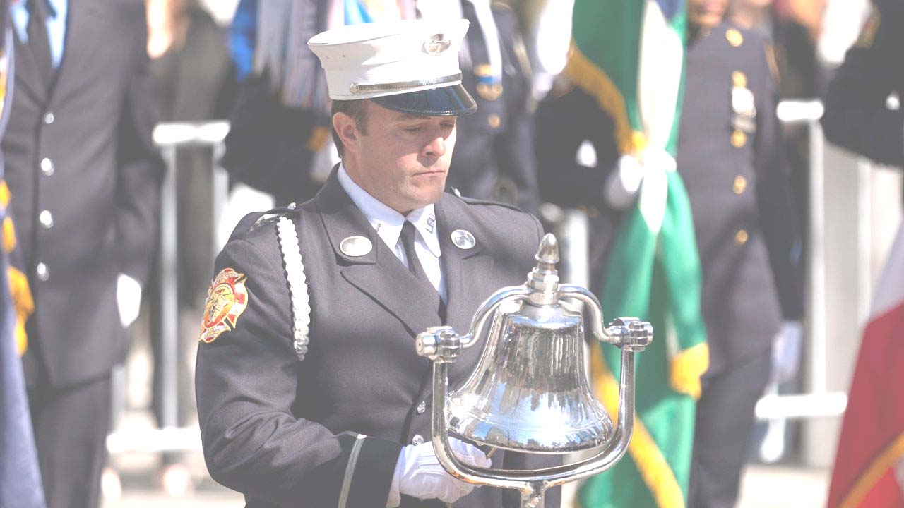
We honor those that died daily by protecting the American way of life, personify what is best about the city, this country and, for what they did on that day.

