Slide 1
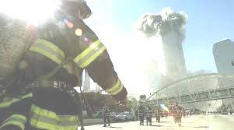
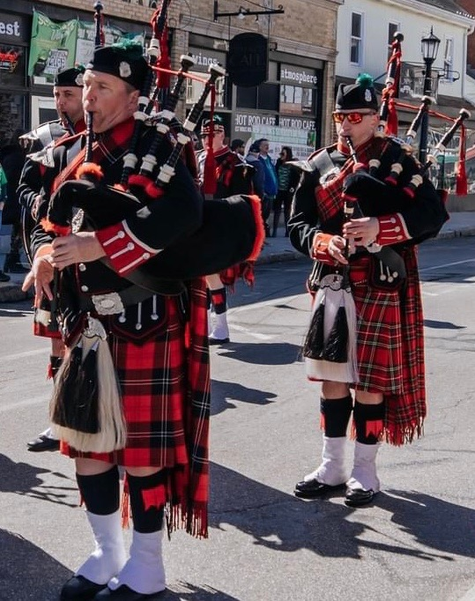

FALLEN FDNY OF THE
911 TERRORIST ATTACKS

Slide 2
At 8:46 a.m. on September 11, 2001, terrorists from the Islamist extreme group al Qaeda hijacked and crashed American Airlines Flight 11 into the north tower of the World Trade Center in New York City. Six minutes later, the first contingent of New York City firefighters—two ladder and two engine companies—had arrived at the stricken building. They had just begun to climb a stairwell in an effort to reach people trapped on the upper floors, when another hijacked airliner, United Airlines Flight 175, struck the south tower at 9:03 a.m.

Slide 3
The first fatality occurred at approximately 9:30 a.m., when a civilian leaping from the south tower struck firefighter Daniel Suhr, according to the 9/11 commission report and an oral history interview with FDNY Captain Paul Conlon, who witnessed it. “It wasn’t like you heard something falling and could jump out of the way,” Conlon recalled.

Slide 4
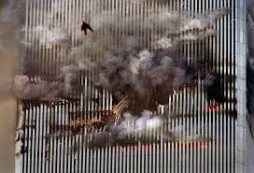

Slide 5
At 9:59 a.m., the south tower suddenly disintegrated, collapsing into itself in just 10 seconds after burning for 56 minutes. More than 800 people in and around the building are killed.
There was no time to flee, and the collapse killed all the firefighters and emergency personnel inside the building.
The north tower began to collapse at 10:28 a.m. after burning for 102 minutes. More than 1,600 in and around the building are killed.

Slide 6
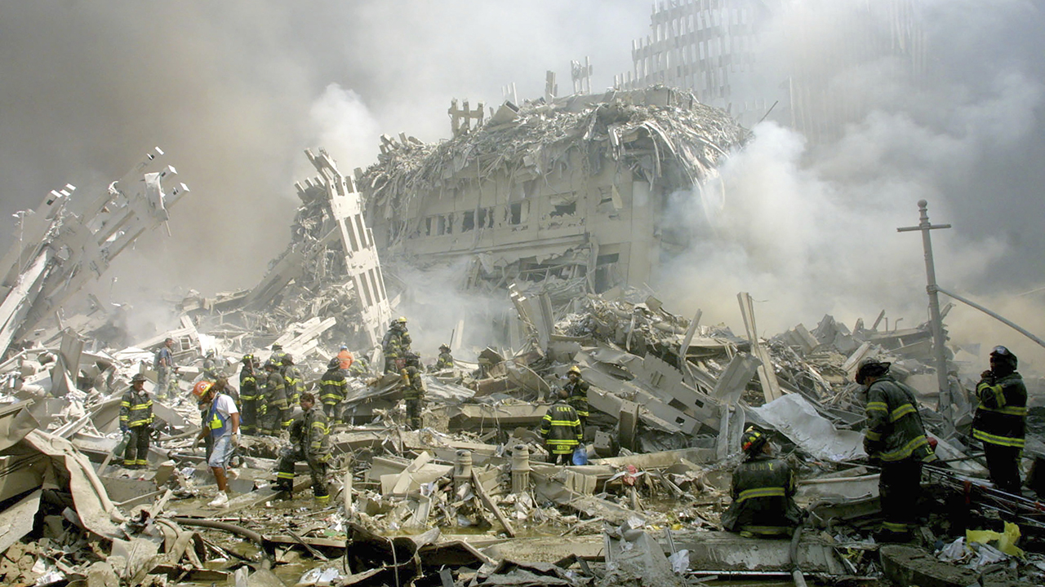

Slide 7
On that fatal morning, 343 New York City Fire Department (FDNY) firefighters made the ultimate sacrifice as well as 2,983 men, women, and children who were killed at the World Trade Center.

Slide 8
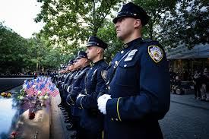

Slide 9
