Slide 1
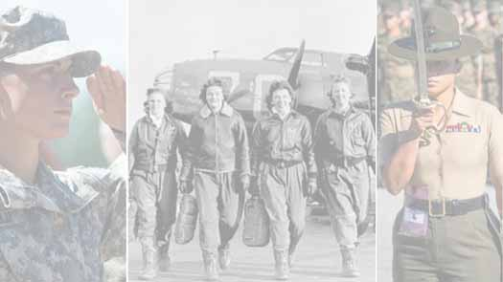
WOMEN IN THE ARMED FORCES

Slide 2
From the battlefields of the American Revolution to
the deserts of Kuwait, women have been serving in
the military in one form or another for more than 200
years.
Although women were not always permitted to enlist
in the U.S. Armed Forces, many still found ways to
serve their nation.
During the Revolutionary War, as colonial militias
armed themselves and joined George Washington’s
Continental Army, many of these soldiers’ wives,
sisters, daughters and mothers went with them.

Slide 3
These women traveled alongside the Continental
Army, where they boosted morale as well as mended
clothes, tended to wounds, foraged for food, cooked
and cleaned both laundry and cannons.
During the Civil War, nearly 20,000 women lent their skills and efforts in everything from growing crops to feed Union troops to cooking in Army camps. Other tasks included sewing, laundering uniforms and blankets and organizing donations through door-to-door fundraising campaigns.

Slide 4
It was during the Civil War that women began to serve as nurses on a much larger and more official scale. Approximately 3,000 women served as nurses for the Union Army during the war.
At the onset of the United States’ entry into World War I in April 1917, the U.S. Army Nurse Corps (ANC) – formally established in 1901 – had only officially been in existence for less than 20 years, and only had 403 nurses in its active-duty ranks. By June 1918, just over a year later, there were more than 3,000 American nurses deployed to British-operated hospitals in France.

Slide 5
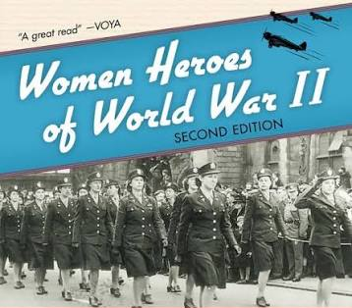
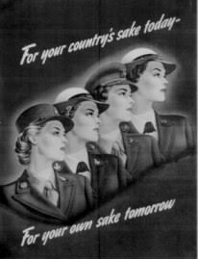
In 1948, Congress passed the Women's Armed
Services Integration Act, allowing women to serve as
permanent members
of the military.
Women make up approximately 20% of the nearly 400,000 active-duty and reserve service members.

Slide 6
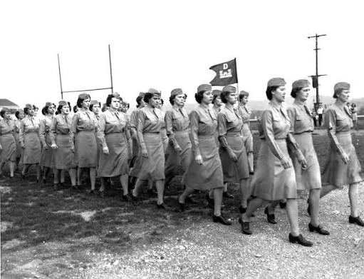
WWII created an unprecedented need for service members. As more than 16 million Americans stepped up to serve on the front lines – the majority of those being men – the U.S. military was left with many non-combat
roles that needed to be filled. So, the women of the United States stepped up too, and for the first time in history, all branches of the military enlisted women in their ranks.

Slide 7
U.S. Army
        The Army formed the Women’s Army Auxiliary Corps (WAACs), which was later renamed and restructured to form the active duty Women’s Army Corps (WACS). The branch also formed the Army’s Women Airforce Service Pilots (WASPS).
U.S. Navy
The Navy formed the Women Accepted for Volunteer Emergency Service (WAVES).

Slide 8
U.S. Marine Corps
The Marines enlisted women in the Marine Corps Women’s Reserve.
U.S. Coast Guard
The Coast Guard formed the Women’s Reserve (SPARS), which stood for the Coast Guard motto, Semper Paratus – “Always Ready.”

Slide 9
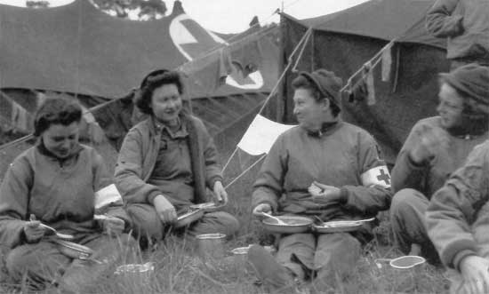
In total, nearly 350,000 American women served in uniform during World War II. Women also served as
nurses. 57,000 served in the Army Nurse Corps and 11,000 in the Navy Nurse Corps – and these roles were not without risk. Many of these women worked right on the
front lines and came under enemy fire, and some even won combat decorations.

Slide 10
In 1950, the Korean War broke out, and 120,000 women would go on to serve in active duty positions from 1950-1953. Although they could not serve in combat, they undertook new roles such as military police officers or engineers. Military nurses would also continue to play a critical role during this time. Mobile Army Surgical Hospitals (MASH) were heavily used during the Korean War, providing fully functioning hospitals in combat zones, where many nurses worked.
Just a few years later in the Vietnam War, these nurses would be called to the front lines once again.

Slide 11
Approximately 11,000 women were stationed in Vietnam during the nearly 20-year war, and 90% of them were nurses in the Army, Navy and Air Force. Notably, most volunteered to go.
At the end of the 20th century and the beginning of the 21st, there were a lot of “firsts” for women in the military: the first woman to become a Navy fighter pilot; the first female four-star general in the Army, and the first female rescue swimmer in the Coast Guard, among others.

Slide 12
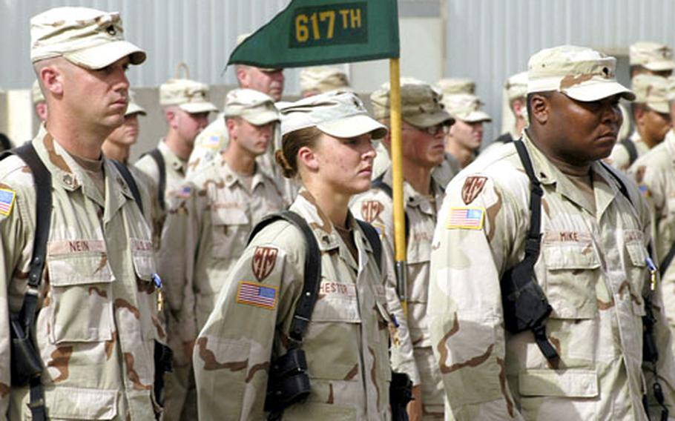
The first Silver Star awarded to a female soldier since World War II was awarded to Army Sgt. Leigh Ann Hester in recognition of her brave actions during an enemy
ambush on her supply convoy in Iraq in 2005. She is also the first woman to ever receive the Silver Star for direct combat action.

